Slide 1
Section 4
Computer Graphics

Slide 2
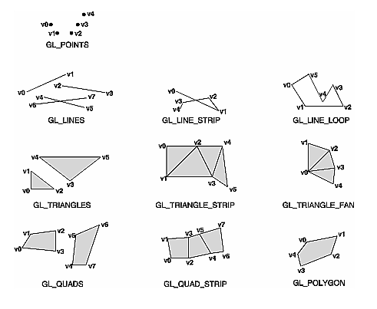
glBegin()
The ten possible arguments for glBegin()

Slide 3
GL_TRIANGLES
Draws a series of triangles using vertices v0, v1, v2, then v3, v4, v5, and so on. If n isn't an exact multiple of 3, the final one or two vertices are ignored.

Slide 4
GL_TRIANGLE_STRIP
Draws a series of triangles using vertices v0, v1, v2, then v2, v1, v3 (note the order), then v2, v3, v4, then 4,3,5 and so on.

Slide 5
GL_TRIANGLE_FAN
Same as GL_TRIANGLE_STRIP, except that the vertices are v0, v1, v2, then v0, v2, v3, then v0, v3, v4, and so on.

Slide 6
GL_QUADS
Draws a series of quadrilaterals using vertices v0, v1, v2, v3, then v4, v5, v6, v7, and so on. If n isn't a multiple of 4, the final one, two, or three vertices are ignored.

Slide 7
GL_QUAD_STRIP
Draws a series of quadrilaterals beginning with v0, v1, v3, v2, then v2, v3, v5, v4, then v4, v5, v7, v6, and so on. n must be at least 4 before anything is drawn. If n is odd, the final vertex is ignored.

Slide 8
GL_POLYGON
Draws a polygon using the points v0, ... , vn-1 as vertices. n must be at least 3, or nothing is drawn. In addition, the polygon specified must not intersect itself. If the vertices don't satisfy these conditions, the results are unpredictable.

Slide 9
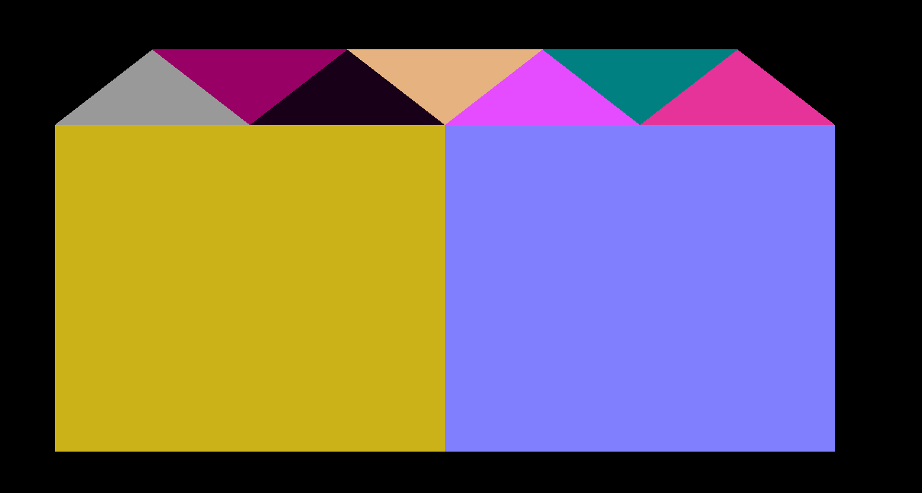
Draw this shape

Slide 10
#include<GL\glut.h> void display() { glClear(GL_COLOR_BUFFER_BIT); glBegin(GL_QUADS); glColor3f(0.8, 0.7, 0.1); glVertex2f(-.8, -.8); glVertex2f(-.8,.5); glVertex2f(0, 0.5); glVertex2f(0, -.8); glEnd(); glBegin(GL_QUADS); glColor3f(0.5, 0.5, 1.0); glVertex2f(0, 0.5); glVertex2f(0, -.8); glVertex2f(.8, -.8); glVertex2f(.8, .5); glEnd(); | glBegin(GL_TRIANGLES); glColor3f(0.6, 0.6, 0.6); glVertex2f(-0.8, .5); glVertex2f(-0.6, .8); glVertex2f(-0.4, .5); glEnd(); glBegin(GL_TRIANGLES); glColor3f(0.6, 0.0, 0.4); glVertex2f(-0.6, .8); glVertex2f(-0.4, .5); glVertex2f(-0.2, .8); glEnd(); glBegin(GL_TRIANGLES); glColor3f(0.1, 0.0, 0.1); glVertex2f(-0.4, .5); glVertex2f(-0.2, .8); glVertex2f(0.0, .5); glEnd(); | glBegin(GL_TRIANGLES); glColor3f(.9, 0.7, 0.5); glVertex2f(-0.2, .8); glVertex2f(0.0, .5); glVertex2f(0.2, .8); glEnd(); glBegin(GL_TRIANGLES); glColor3f(0.9, 0.3, 1.0); glVertex2f(0, 0.5); glVertex2f(0.2, .8); glVertex2f(.4, 0.5); glEnd(); glBegin(GL_TRIANGLES); glColor3f(0.0, 0.5, 0.5); glVertex2f(0.2, .8); glVertex2f(0.4, .5); glVertex2f(0.6, .8); glEnd(); | glBegin(GL_TRIANGLES); glColor3f(0.9, 0.2, 0.6); glVertex2f(0.4, .5); glVertex2f(0.6, .8); glVertex2f(0.8, .5); glEnd(); glutSwapBuffers(); } int main(int argc, char** argv) { glutInit(&argc, argv); glutInitDisplayMode(GLUT_DOUBLE | GLUT_RGB); glutInitWindowSize(350, 150); glutInitWindowPosition(100, 100); glutCreateWindow("GL_POINTS"); glutDisplayFunc(display); glutMainLoop(); return 0; }

Slide 11
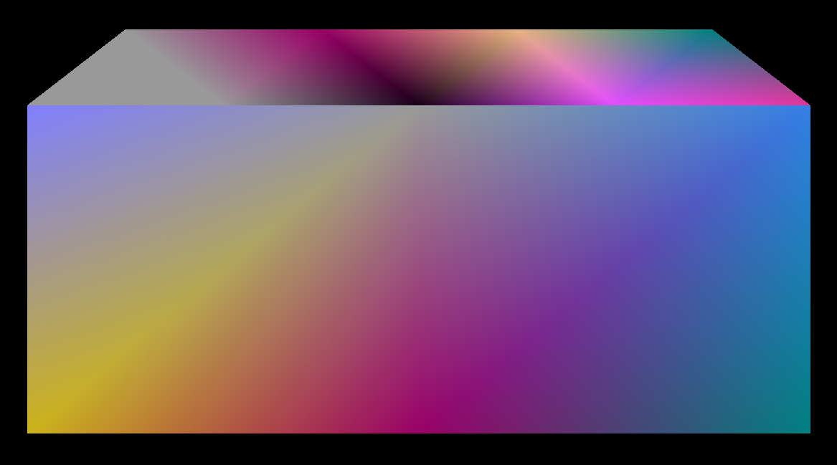
Draw this shape

Slide 12
#include<GL\glut.h> void display() { glClear(GL_COLOR_BUFFER_BIT); glBegin(GL_QUAD_STRIP); glColor3f(0.8, 0.7, 0.1); glVertex2f(-.8, -.8); glColor3f(0.5, 0.5, 1.0); glVertex2f(-.8,.5); glColor3f(0.6, 0.0, 0.4); glVertex2f(0, -.8); glColor3f(0.6, 0.6, 0.6); glVertex2f(0, 0.5); glColor3f(0.0, 0.5, 0.5); glVertex2f(.8, -.8); glColor3f(0.2, 0.5, 0.9); glVertex2f(.8, .5); glEnd(); glBegin(GL_TRIANGLE_STRIP); glColor3f(0.6, 0.6, 0.6); glVertex2f(-0.8, .5);//0 glVertex2f(-0.6, .8);//1 glVertex2f(-0.4, .5);//2 glColor3f(0.6, 0.0, 0.4); | glVertex2f(-0.2, .8);//3 glColor3f(0.1, 0.0, 0.1); glVertex2f(0.0, .5);//4 glColor3f(.9, 0.7, 0.5); glVertex2f(0.2, .8);//5 glColor3f(0.9, 0.3, 1.0); glVertex2f(.4, 0.5);//6 glColor3f(0.0, 0.5, 0.5); glVertex2f(0.6, .8);//7 glColor3f(0.9, 0.2, 0.6); glVertex2f(0.8, .5);//8 glEnd(); glutSwapBuffers(); } int main(int argc, char** argv) { glutInit(&argc, argv); glutInitDisplayMode(GLUT_DOUBLE | GLUT_RGB); glutInitWindowSize(350, 150); glutInitWindowPosition(100, 100); glutCreateWindow("Primitives"); glutDisplayFunc(display); glutMainLoop(); return 0; }

Slide 13
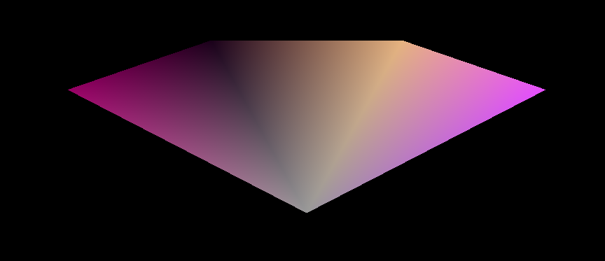

Slide 14
#include<GL\glut.h> void display() { glClear(GL_COLOR_BUFFER_BIT); glBegin(GL_TRIANGLE_FAN); glColor3f(0.6, 0.6, 0.6); glVertex2f(0,0);//0 glColor3f(0.6, 0.0, 0.4); glVertex2f(-.5, .5);//1 glColor3f(0.1, 0.0, 0.1); glVertex2f(-0.2, .7);//2 glColor3f(.9, 0.7, 0.5); glVertex2f(0.2, .7);//3 glColor3f(0.9, 0.3, 1.0); glVertex2f(.5, 0.5);//4 glEnd(); glutSwapBuffers(); } | int main(int argc, char** argv) { glutInit(&argc, argv); glutInitDisplayMode(GLUT_DOUBLE | GLUT_RGB); glutInitWindowSize(350, 150); glutInitWindowPosition(100, 100); glutCreateWindow("Primitives"); glutDisplayFunc(display); glutMainLoop(); return 0; }

Slide 15
3D
Z axis from -1 to 1
- into the screen
+ zooming out toward the viewer

Slide 16
glClearDepth
glClearDepth specifies the depth value used by glClear to clear the depth buffer.
Values specified by glClearDepth are clamped to the range 0 1 .
Usage: glClearDepth(depth);

Slide 17
glDepthFunc
glDepthFunc specifies the function used to compare each incoming pixel depth value with the depth value present in the depth buffer. The comparison is performed only if depth testing is enabled.
Usage: glEnable(GL_DEPTH_TEST);
glDepthFunc(func);

Slide 18
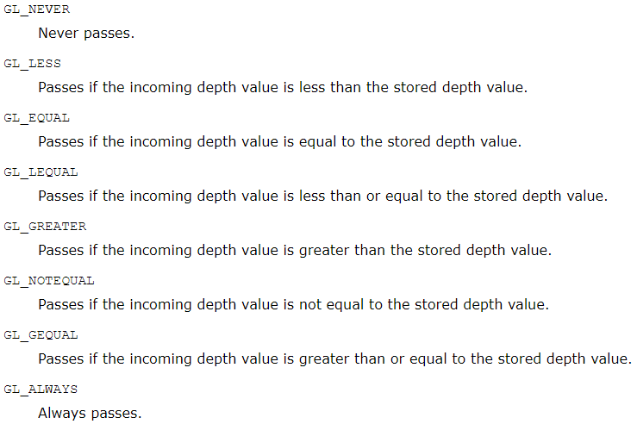
glDepthFunc

Slide 19
glMatrixMode
glMatrixMode - specify which matrix is the current matrix
Usage: glMatrixMode(mode)
GL_MODELVIEW(Coordinates of the natural world)
Applies subsequent matrix operations to the modelview matrix stack.
GL_PROJECTION(Computer coordinates)
Applies subsequent matrix operations to the projection matrix stack.

Slide 20
glLoadIdentity()
glLoadIdentity — replace the current matrix with the identity matrix
Usage: glLoadIdentity();

Slide 21
glViewport()
glViewport() — set the viewport
Usage:glViewport(x, y, width, height);
x, y: Specify the lower left corner of the viewport rectangle, in pixels. The initial value is (0,0).
width, height: Specify the width and height of the viewport. When a GL context is first attached to a window, width and height are set to the dimensions of that window.

